Slide 1
Data Centric RAD
Bachelor of Science (Honours) in Computing in Software Development
Bachelor of Science in Computing in Software
Development
Department of Computer Science & Applied Physics

Slide 2
Review of MySQL - Insert
Inserting new data in to a table is done using the INSERT command.
Insert into <table>
values <column1_value, column2_value, column3_value>;
Insert into <table>
<column1_name, column3_name>
values <column1_value, column3_value>;

Slide 3
Review of MySQL - Insert
How would you add a superhero called Joker, whose real name is Jack Nicholson and who lives in Gotham City?
Insert into Superhero_Table
values (‘Joker’, ‘Gotham City’, ‘Jack’, ‘Nicholson’);
Superhero_Table
Name | City | Real_First_Name | Real_Surname
Spiderman | New York | Peter | Parker
Superman | Metropolis | Clark | Kent
Batman | Gotham City | Bruce | Wayne

Slide 4
Review of MySQL - Insert
How would you add a superhero called Joker, whose real name is Jack Nicholson but you want to leave the City blank?
Insert into Superhero_Table (Name, Real_First_Name, Real_Surname)
values (‘Joker’, ‘Jack’, ‘Nicholson’);
Superhero_Table
Name | City | Real_First_Name | Real_Surname
Spiderman | New York | Peter | Parker
Superman | Metropolis | Clark | Kent
Batman | Gotham City | Bruce | Wayne

Slide 5
Review of MySQL - Delete
Deleting data from a table is done using the DELETE command.
Delete From <table>;
Delete From <table>
Where <condition>;

Slide 6
Review of MySQL - Delete
Given the following table, how would you delete the superheroes with man at the end of their name?
delete from superhero_table
where name like '%man';
Superhero_Table
Name | City | Real_First_Name | Real_Surname
Spiderman | New York | Peter | Parker
Superman | Metropolis | Clark | Kent
Batman | Gotham City | Bruce | Wayne
Joker | Gotham City | Jack | Nicholson
Batgirl | New York | Barbara | Gordon

Slide 7
Review of MySQL - Delete
Given the following table, how would you delete the superheroes with man at the end of their name, and who live in Gotham City?
delete from superhero_table
where name like '%man‘
and city like ‘Gotham%’;
Superhero_Table
Name | City | Real_First_Name | Real_Surname
Spiderman | New York | Peter | Parker
Superman | Metropolis | Clark | Kent
Batman | Gotham City | Bruce | Wayne
Joker | Gotham City | Jack | Nicholson
Batgirl | New York | Barbara | Gordon

Slide 8
Review of MySQL - Update
Updating data in a table is done using the UPDATE command.
Update <table>
Set <column_name> = <value>;
Update <table>
Set <column_name> = <value>
Where <condition>;

Slide 9
Review of MySQL - Update
Superhero_Table
Name | City | Real_First_Name | Real_Surname | DOB | Powers
Spiderman | New York | Peter | Parker | 1980-01-01 | 76.88
Superman | Metropolis | Clark | Kent | 1980-11-22 | 99.00
Batman | Gotham City | Bruce | Wayne | 1960-11-12 | 97.45
Spiderman | Metropolis | Bruce | Clark | 1980-01-27 | 7.00
Batman | Metropolis | Bruce | Wayne | 1960-11-12 | 76.88
Batgirl | Gotham City | Barbara | Gordon | 1995-12-07 | 98.05
Radioactiveman | Springfield | NULL | NULL | 2000-07-04 | 76.88
Update the powers of all superheroes to 55.01.

Slide 10
Review of MySQL - Update
Superhero_Table
Name | City | Real_First_Name | Real_Surname | DOB | Powers
Spiderman | New York | Peter | Parker | 1980-01-01 | 55.01
Superman | Metropolis | Clark | Kent | 1980-11-22 | 55.01
Batman | Gotham City | Bruce | Wayne | 1960-11-12 | 55.01
Spiderman | Metropolis | Bruce | Clark | 1980-01-27 | 55.01
Batman | Metropolis | Bruce | Wayne | 1960-11-12 | 55.01
Batgirl | Gotham City | Barbara | Gordon | 1995-12-07 | 55.01
Radioactiveman | Springfield | NULL | NULL | 2000-07-04 | 55.01
update superhero_table
set powers = 55.01;

Slide 11
Review of MySQL - Update
Superhero_Table
Name | City | Real_First_Name | Real_Surname | DOB | Powers
Spiderman | New York | Peter | Parker | 1980-01-01 | 76.88
Superman | Metropolis | Clark | Kent | 1980-11-22 | 99.00
Batman | Gotham City | Bruce | Wayne | 1960-11-12 | 97.45
Spiderman | Metropolis | Bruce | Clark | 1980-01-27 | 7.00
Batman | Metropolis | Bruce | Wayne | 1960-11-12 | 76.88
Batgirl | Gotham City | Barbara | Gordon | 1995-12-07 | 98.05
Radioactiveman | Springfield | NULL | NULL | 2000-07-04 | 76.88
Update the powers of all superheroes living in Metropolis to 55.01.

Slide 12
Review of MySQL - Update
Superhero_Table
Name | City | Real_First_Name | Real_Surname | DOB | Powers
Spiderman | New York | Peter | Parker | 1980-01-01 | 76.88
Superman | Metropolis | Clark | Kent | 1980-11-22 | 55.01
Batman | Gotham City | Bruce | Wayne | 1960-11-12 | 97.45
Spiderman | Metropolis | Bruce | Clark | 1980-01-27 | 55.01
Batman | Metropolis | Bruce | Wayne | 1960-11-12 | 55.01
Batgirl | Gotham City | Barbara | Gordon | 1995-12-07 | 98.05
Radioactiveman | Springfield | NULL | NULL | 2000-07-04 | 76.88
update superhero_table
set powers = 55.01
where city like 'Metropolis';

Slide 13
Review of MySQL - Update
Superhero_Table
Name | City | Real_First_Name | Real_Surname | DOB | Powers
Spiderman | New York | Peter | Parker | 1980-01-01 | 76.88
Superman | Metropolis | Clark | Kent | 1980-11-22 | 99.00
Batman | Gotham City | Bruce | Wayne | 1960-11-12 | 97.45
Spiderman | Metropolis | Bruce | Clark | 1980-01-27 | 7.00
Batman | Metropolis | Bruce | Wayne | 1960-11-12 | 76.88
Batgirl | Gotham City | Barbara | Gordon | 1995-12-07 | 98.05
Radioactiveman | Springfield | NULL | NULL | 2000-07-04 | 76.88
Increase the powers of all superheroes born in November by .5.

Slide 14
Review of MySQL - Update
Superhero_Table
Name | City | Real_First_Name | Real_Surname | DOB | Powers
Spiderman | New York | Peter | Parker | 1980-01-01 | 76.88
Superman | Metropolis | Clark | Kent | 1980-11-22 | 99.50
Batman | Gotham City | Bruce | Wayne | 1960-11-12 | 97.95
Spiderman | Metropolis | Bruce | Clark | 1980-01-27 | 7.00
Batman | Metropolis | Bruce | Wayne | 1960-11-12 | 77.38
Batgirl | Gotham City | Barbara | Gordon | 1995-12-07 | 98.05
Radioactiveman | Springfield | NULL | NULL | 2000-07-04 | 76.88
update superhero_table
set powers = powers + .5
where MONTH(dob) = 11;

Slide 15
Review of MySQL – Aggregate Functions
An aggregate function performs a calculation on a set of values and returns a single value.
Most common aggregate functions are:
MIN
MAX
SUM
AVG
COUNT

Slide 16
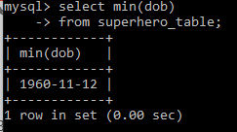
Review of MySQL - MIN
MIN returns the minimum of a set of values
NULL values excluded (unless all values are NULL)
Show the DOB of the oldest superhero.
select min(dob)
from superhero_table;
Superhero_Table
Name | City | Real_First_Name | Real_Surname | DOB | Powers
Spiderman | New York | Peter | Parker | 1980-01-01 | 76.88
Superman | Metropolis | Clark | Kent | 1980-11-22 | 99.00
Batman | Gotham City | Bruce | Wayne | 1960-11-12 | 97.45
Spiderman | Metropolis | Bruce | Clark | 1980-01-27 | 7.00
Batman | Metropolis | Bruce | Wayne | 1960-11-12 | 76.88
Batgirl | Gotham City | Barbara | Gordon | 1995-12-07 | 98.05
Radioactiveman | Springfield | NULL | NULL | 2000-07-04 | 76.88

Slide 17
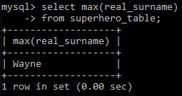
Review of MySQL - MAX
MAX returns the maximum of a set of values
NULL values excluded (unless all values are NULL)
Show the Real_Surname of the superhero whose name is last in alphabetical order.
select max(real_surname)
from superhero_table;
Superhero_Table
Name | City | Real_First_Name | Real_Surname | DOB | Powers
Spiderman | New York | Peter | Parker | 1980-01-01 | 76.88
Superman | Metropolis | Clark | Kent | 1980-11-22 | 99.00
Batman | Gotham City | Bruce | Wayne | 1960-11-12 | 97.45
Spiderman | Metropolis | Bruce | Clark | 1980-01-27 | 7.00
Batman | Metropolis | Bruce | Wayne | 1960-11-12 | 76.88
Batgirl | Gotham City | Barbara | Gordon | 1995-12-07 | 98.05
Radioactiveman | Springfield | NULL | NULL | 2000-07-04 | 76.88

Slide 18
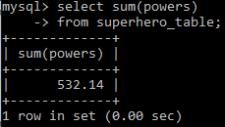
Review of MySQL - SUM
SUM returns the sum of a set of values
NULL values excluded (unless all values are NULL)
Show the combined Powers of the all superheroes.
select sum(powers)
from superhero_table;
Superhero_Table
Name | City | Real_First_Name | Real_Surname | DOB | Powers
Spiderman | New York | Peter | Parker | 1980-01-01 | 76.88
Superman | Metropolis | Clark | Kent | 1980-11-22 | 99.00
Batman | Gotham City | Bruce | Wayne | 1960-11-12 | 97.45
Spiderman | Metropolis | Bruce | Clark | 1980-01-27 | 7.00
Batman | Metropolis | Bruce | Wayne | 1960-11-12 | 76.88
Batgirl | Gotham City | Barbara | Gordon | 1995-12-07 | 98.05
Radioactiveman | Springfield | NULL | NULL | 2000-07-04 | 76.88

Slide 19
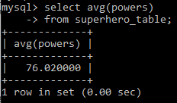
Review of MySQL - AVG
AVG returns the average of a set of values
NULL values excluded (unless all values are NULL)
Show the average Powers of the all superheroes.
select avg(powers)
from superhero_table;
Superhero_Table
Name | City | Real_First_Name | Real_Surname | DOB | Powers
Spiderman | New York | Peter | Parker | 1980-01-01 | 76.88
Superman | Metropolis | Clark | Kent | 1980-11-22 | 99.00
Batman | Gotham City | Bruce | Wayne | 1960-11-12 | 97.45
Spiderman | Metropolis | Bruce | Clark | 1980-01-27 | 7.00
Batman | Metropolis | Bruce | Wayne | 1960-11-12 | 76.88
Batgirl | Gotham City | Barbara | Gordon | 1995-12-07 | 98.05
Radioactiveman | Springfield | NULL | NULL | 2000-07-04 | 76.88

Slide 20
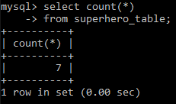
Review of MySQL - COUNT
COUNT returns the number of rows
NULL values included if all columns are counted
NULL values excluded if only one column counted
Get the number of superheroes.
Select count(*)
from superhero_table;
Superhero_Table
Name | City | Real_First_Name | Real_Surname | DOB | Powers
Spiderman | New York | Peter | Parker | 1980-01-01 | 76.88
Superman | Metropolis | Clark | Kent | 1980-11-22 | 99.00
Batman | Gotham City | Bruce | Wayne | 1960-11-12 | 97.45
Spiderman | Metropolis | Bruce | Clark | 1980-01-27 | 7.00
Batman | Metropolis | Bruce | Wayne | 1960-11-12 | 76.88
Batgirl | Gotham City | Barbara | Gordon | 1995-12-07 | 98.05
Radioactiveman | Springfield | NULL | NULL | 2000-07-04 | 76.88

Slide 21
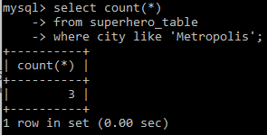
Review of MySQL - COUNT
COUNT returns the number of rows
NULL values included if all columns are counted
NULL values excluded if only one column counted
Get the number of superheroes in Metropolis
Select count(*)
from superhero_table
where city like 'Metropolis';
Superhero_Table
Name | City | Real_First_Name | Real_Surname | DOB | Powers
Spiderman | New York | Peter | Parker | 1980-01-01 | 76.88
Superman | Metropolis | Clark | Kent | 1980-11-22 | 99.00
Batman | Gotham City | Bruce | Wayne | 1960-11-12 | 97.45
Spiderman | Metropolis | Bruce | Clark | 1980-01-27 | 7.00
Batman | Metropolis | Bruce | Wayne | 1960-11-12 | 76.88
Batgirl | Gotham City | Barbara | Gordon | 1995-12-07 | 98.05
Radioactiveman | Springfield | NULL | NULL | 2000-07-04 | 76.88

Slide 22
Review of MySQL – Group By
The Group By clause groups rows into subgroups based on values of columns or expressions.
Usually used with Aggregate Functions.

Slide 23
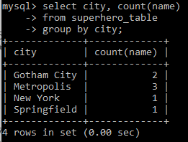
Review of MySQL – Group By
Superhero_Table
Name | City | Real_First_Name | Real_Surname | DOB | Powers
Spiderman | New York | Peter | Parker | 1980-01-01 | 76.88
Superman | Metropolis | Clark | Kent | 1980-11-22 | 99.00
Batman | Gotham City | Bruce | Wayne | 1960-11-12 | 97.45
Spiderman | Metropolis | Bruce | Clark | 1980-01-27 | 7.00
Batman | Metropolis | Bruce | Wayne | 1960-11-12 | 76.88
Batgirl | Gotham City | Barbara | Gordon | 1995-12-07 | 98.05
Radioactiveman | Springfield | NULL | NULL | 2000-07-04 | 76.88
Show the name of each city and the number of superheroes in the city.
select city, count(name)
from superhero_table
group by city;

Slide 24
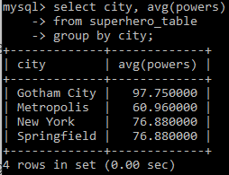
Review of MySQL – Group By
Superhero_Table
Name | City | Real_First_Name | Real_Surname | DOB | Powers
Spiderman | New York | Peter | Parker | 1980-01-01 | 76.88
Superman | Metropolis | Clark | Kent | 1980-11-22 | 99.00
Batman | Gotham City | Bruce | Wayne | 1960-11-12 | 97.45
Spiderman | Metropolis | Bruce | Clark | 1980-01-27 | 7.00
Batman | Metropolis | Bruce | Wayne | 1960-11-12 | 76.88
Batgirl | Gotham City | Barbara | Gordon | 1995-12-07 | 98.05
Radioactiveman | Springfield | NULL | NULL | 2000-07-04 | 76.88
Show the name of each city and the average powers of superheroes in the city.
select city, avg(powers)
from superhero_table
group by city;

Slide 25
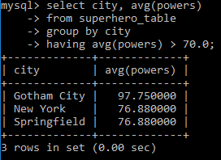
Review of MySQL – Having
The HAVING clause is used to specify conditions for a Group By clause.
Similar to WHERE clause.
Show the name of each city and the average powers of superheroes in the city for cities where the average powers > 70.0.
select city, avg(powers)
from superhero_table
group by city
having avg(powers) > 70.0;
Superhero_Table
Name | City | Real_First_Name | Real_Surname | DOB | Powers
Spiderman | New York | Peter | Parker | 1980-01-01 | 76.88
Superman | Metropolis | Clark | Kent | 1980-11-22 | 99.00
Batman | Gotham City | Bruce | Wayne | 1960-11-12 | 97.45
Spiderman | Metropolis | Bruce | Clark | 1980-01-27 | 7.00
Batman | Metropolis | Bruce | Wayne | 1960-11-12 | 76.88
Batgirl | Gotham City | Barbara | Gordon | 1995-12-07 | 98.05
Radioactiveman | Springfield | NULL | NULL | 2000-07-04 | 76.88

Slide 26
Review of MySQL
What are the problems with the following table structure?
Superhero_Table
Name* | City* | Real_First_Name | Real_Surname | dob | powers
Spiderman | New York | Peter | Parker | 1980-01-27 | 71.04
Superman | Metropolis | Clark | Kent | 1980-11-22 | 99.00
Batman | Gotham City | Bruce | Wayne | 1960-11-12 | 97.45
Spiderman | Metropolis | Peter | Parker | 1980-01-27 | 71.04
Batman | Metropolis | Bruce | Wayne | 1960-11-12 | 97.45
Batgirl | Gotham City | Barbara | Gordon | 1995-12-07 | 98.05
Radioactiveman | Springfield | Alan | Jones | 2000-07-04 | 76.88

Slide 27
Review of MySQL
We want to organise data efficiently and reduce the potential for data anomalies.
This is called Normalization.

Slide 28
Normalization
“Normalization is the process of organizing the columns (attributes) and tables (relations) of a relational database to minimize data redundancy”.
Normalization organises data efficiently
Normalization reduces the potential for data anomalies

Slide 29
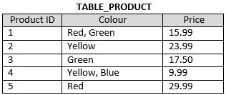
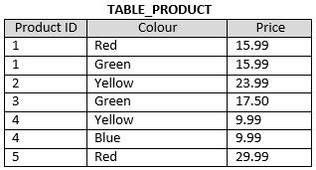
Normal Forms – 1NF
A Database is in 1st Normal Form if it:
Contains only atomic values (there are no repeating groups)
0 NF
1 NF
PK = ProductID
PK = ProductID, Colour

Slide 30
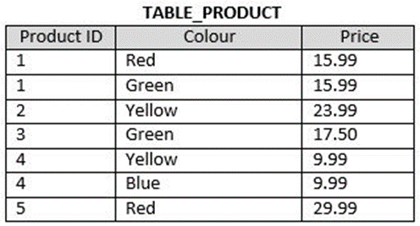
Normal Forms – 2NF
A Database is in 2nd Normal Form if:
It is in 1NF
Every non-key attribute is fully functionally dependent on the entire key
PK = ProductID, Colour

Slide 31
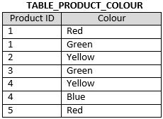
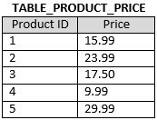
Normal Forms – 2NF
1 NF
PK = ProductID, Colour
2 NF
PK = ProductID, Colour
PK = ProductID

Slide 32
Normal Forms – 3NF
A Database is in 3rd Normal Form if:
It is in 2NF
There is no transitive functional dependency
Functional Dependence
B is dependent on A
C is dependent on B
Therefore C is transitively dependent on A

Slide 33
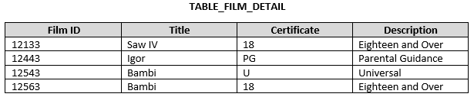
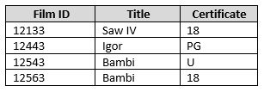

Normal Forms – 3NF
2 NF
PK = Film ID
3 NF
PK = Film ID
PK = Certificate

Slide 34
Superhero_Table
Name* | City* | Real_First_Name | Real_Surname | dob | powers
Spiderman | New York | Peter | Parker | 1980-01-27 | 71.04
Superman | Metropolis | Clark | Kent | 1980-11-22 | 99.00
Batman | Gotham City | Bruce | Wayne | 1960-11-12 | 97.45
Spiderman | Metropolis | Peter | Parker | 1980-01-27 | 71.04
Batman | Metropolis | Bruce | Wayne | 1960-11-12 | 97.45
Batgirl | Gotham City | Barbara | Gordon | 1995-12-07 | 98.05
Radioactiveman | Springfield | Alan | Jones | 2000-07-04 | 76.88
2 NF
Superhero_City_Table
Name* | City*
Spiderman | New York
Superman | Metropolis
Batman | Gotham City
Spiderman | Metropolis
Batman | Metropolis
Batgirl | Gotham City
Radioactiveman | Springfield
Superhero_Table
Name* | Real_First_Name | Real_Surname | dob | powers
Spiderman | Peter | Parker | 1980-01-27 | 71.04
Superman | Clark | Kent | 1980-11-22 | 99.00
Batman | Bruce | Wayne | 1960-11-12 | 97.45
Batgirl | Barbara | Gordon | 1995-12-07 | 98.05
Radioactiveman | Alan | Jones | 2000-07-04 | 76.88
References

Slide 35
Foreign Keys
The Foreign Key is a column in one table that references a column in another table.
The referenced column is usually the Primary Key column.
The Foreign Key ensures Referential Integrity

Slide 36
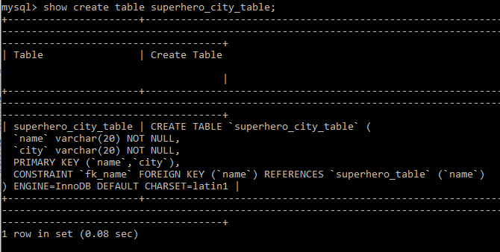
Foreign Key
You can see the Foreign Keys in a Table using the show create table <table> command
Refers to column in other table
Refers to column in this table
Refers to other table

Slide 37
Foreign Keys
What happens if we try to delete Spiderman from the Superhero_Table?
Superhero_City_Table
Name* | City*
Spiderman | New York
Superman | Metropolis
Batman | Gotham City
Spiderman | Metropolis
Batman | Metropolis
Batgirl | Gotham City
Radioactiveman | Springfield
References
Superhero_Table
Name* | Real_First_Name | Real_Surname | dob | powers
Spiderman | Peter | Parker | 1980-01-27 | 71.04
Superman | Clark | Kent | 1980-11-22 | 99.00
Batman | Bruce | Wayne | 1960-11-12 | 97.45
Batgirl | Barbara | Gordon | 1995-12-07 | 98.05
Radioactiveman | Alan | Jones | 2000-07-04 | 76.88

Slide 38
Foreign Keys – On Delete
3 Options when the Referenced Foreign Key is Deleted:
Restrict
The Referenced FK cannot be deleted.
This is the default.
Cascade
The Row Referencing the FK to be deleted is also deleted.
Set NULL
The FK is set to NULL.
Not allowed for Primary Keys.

Slide 39
Foreign Keys – On Delete
Superhero_Table
Name* | Real_First_Name | Real_Surname | dob | powers
Spiderman | Peter | Parker | 1980-01-27 | 71.04
Superman | Clark | Kent | 1980-11-22 | 99.00
Batman | Bruce | Wayne | 1960-11-12 | 97.45
Batgirl | Barbara | Gordon | 1995-12-07 | 98.05
Radioactiveman | Alan | Jones | 2000-07-04 | 76.88
On Delete Cascade
Superhero_City_Table
Name* | City*
Spiderman | New York
Superman | Metropolis
Batman | Gotham City
Spiderman | Metropolis
Batman | Metropolis
Batgirl | Gotham City
Radioactiveman | Springfield

Slide 40
Foreign Keys – On Delete
Superhero_Table
Name* | Real_First_Name | Real_Surname | dob | powers
Spiderman | Peter | Parker | 1980-01-27 | 71.04
Superman | Clark | Kent | 1980-11-22 | 99.00
Batman | Bruce | Wayne | 1960-11-12 | 97.45
Batgirl | Barbara | Gordon | 1995-12-07 | 98.05
Radioactiveman | Alan | Jones | 2000-07-04 | 76.88
On Delete Restrict
Superhero_City_Table
Name* | City*
Spiderman | New York
Superman | Metropolis
Batman | Gotham City
Spiderman | Metropolis
Batman | Metropolis
Batgirl | Gotham City
Radioactiveman | Springfield

Slide 41
Foreign Keys – On Delete
Superhero_Table
Name* | Real_First_Name | Real_Surname | dob | powers
Spiderman | Peter | Parker | 1980-01-27 | 71.04
Superman | Clark | Kent | 1980-11-22 | 99.00
Batman | Bruce | Wayne | 1960-11-12 | 97.45
Batgirl | Barbara | Gordon | 1995-12-07 | 98.05
Radioactiveman | Alan | Jones | 2000-07-04 | 76.88
On Delete Set NULL
(not allowed in this case as name is part of the PK)
Superhero_City_Table
Name* | City*
Spiderman | New York
Superman | Metropolis
Batman | Gotham City
Spiderman | Metropolis
Batman | Metropolis
Batgirl | Gotham City
Radioactiveman | Springfield

